Slide 1


SP3176 The Universe Chapter 3: Light and Atoms (Part 2)
Lim Zhi Han

Slide 2

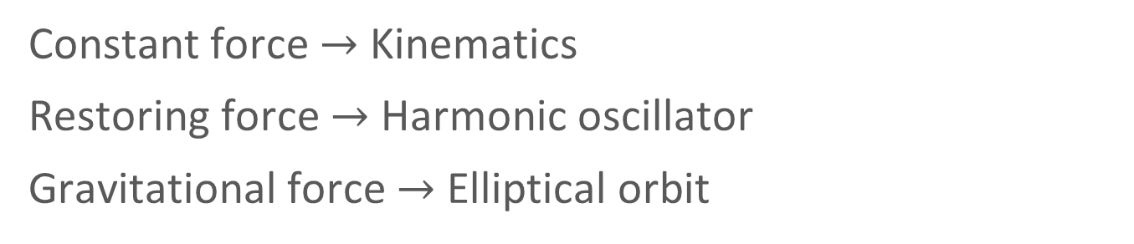
A worthy diversion: Potential Energy
In the previous chapter, we discussed motion under the influence of forces.
Constant force $→$Kinematics
Restoring force $→$ Harmonic oscillator
Gravitational force $→$ Elliptical orbit
Image credit: Alexander Borek, CC-BY-SA-4.0

Slide 3
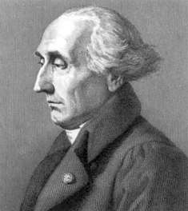



A worthy diversion: Potential Energy
About 100 year later, Lagrange and others reformulated mechanics using concepts of energy.
Kinetic energy $T=\frac{1}{2}mv^{2}=\frac{p^{2}}{2m}$
Potential energy $V=V(x)$
Joseph-Louis Lagrange
Total energy $E=\frac{p^{2}}{2m}+V(x)$
Image: PD, Wikimedia Commons

Slide 4

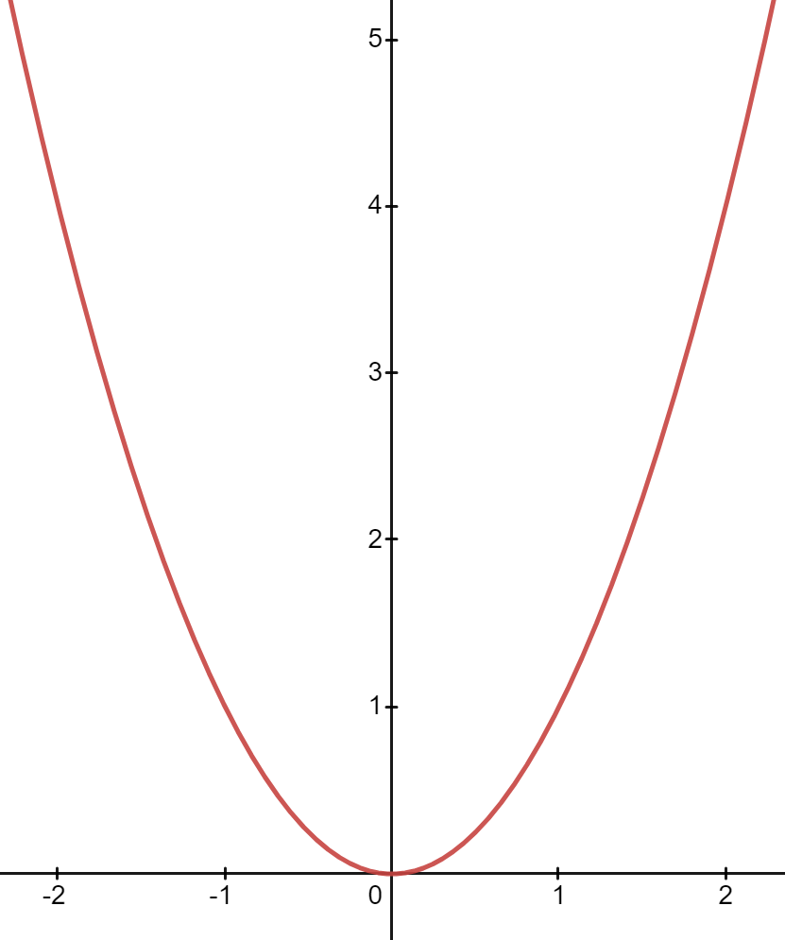
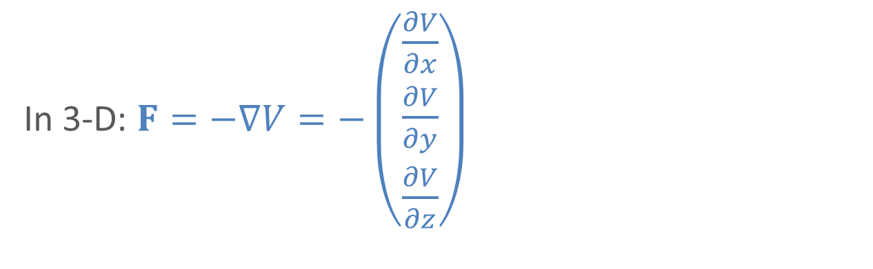

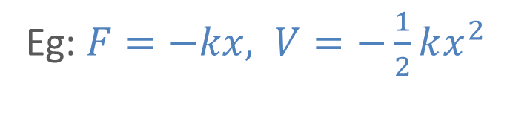
A worthy diversion: Potential Energy
The link between Force and Potential energy is
Image: Flaticon.com
In 1-D: $F=−\frac{dV}{dx}$
Eg: $F=−kx, V=−\frac{1}{2}kx^{2}$
In 3-D: $F=−∇V=−\left(\begin{matrix}\frac{∂V}{∂x} \\ \frac{∂V}{∂y} \\ \frac{∂V}{∂z}\end{matrix}\right)$

Slide 5
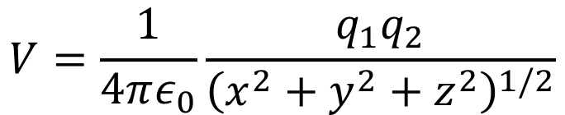
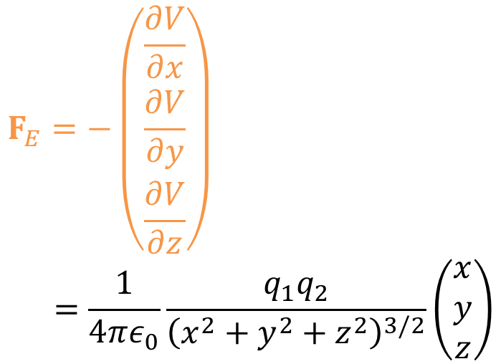
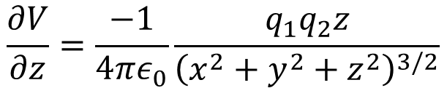
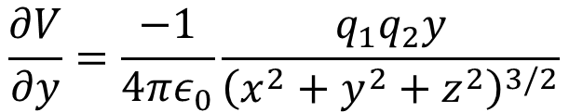
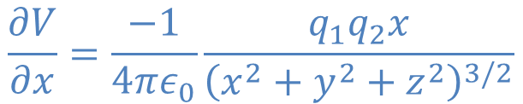
Force and potential (pre-lesson homework)
$$V=\frac{1}{4πε_{0}}\frac{q_{1}q_{2}}{{\left(x^{2}+y^{2}+z^{2}\right)}^{1/2}}$$
$$\frac{∂V}{∂x}=\frac{−1}{4πε_{0}}\frac{q_{1}q_{2}x}{{\left(x^{2}+y^{2}+z^{2}\right)}^{3/2}}$$
$$F_{E}=−\left(\begin{matrix}\frac{∂V}{∂x} \\ \frac{∂V}{∂y} \\ \frac{∂V}{∂z}\end{matrix}\right) \\ =\frac{1}{4πε_{0}}\frac{q_{1}q_{2}}{{\left(x^{2}+y^{2}+z^{2}\right)}^{3/2}}\left(\begin{matrix}x \\ y \\ z\end{matrix}\right)$$
$$\frac{∂V}{∂y}=\frac{−1}{4πε_{0}}\frac{q_{1}q_{2}y}{{\left(x^{2}+y^{2}+z^{2}\right)}^{3/2}}$$
$$\frac{∂V}{∂z}=\frac{−1}{4πε_{0}}\frac{q_{1}q_{2}z}{{\left(x^{2}+y^{2}+z^{2}\right)}^{3/2}}$$

Slide 6
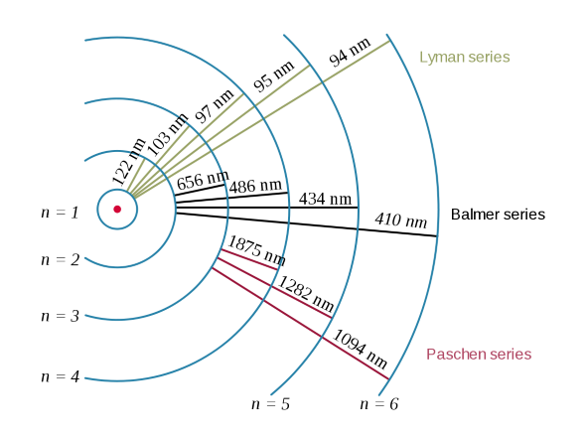

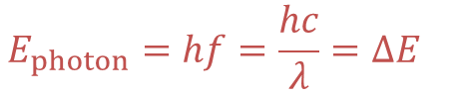
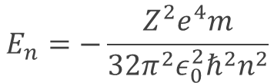
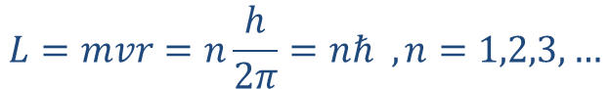
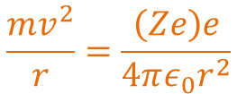
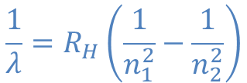
Recall Bohr’s atomic model
$$\frac{mv^{2}}{r}=\frac{\left(Ze\right)e}{4πε_{0}r^{2}}$$
P1:
$$L=mvr=n\frac{h}{2π}=nℏ , n=1,2,3,…$$
P2:
$$E_{n}=−\frac{Z^{2}e^{4}m}{32π^{2}ε_{0}^{2}ℏ^{2}n^{2}}$$
P1 and P2:
$$E_{photon}=hf=\frac{hc}{λ}=ΔE$$
P3:
Balmer series
$$\frac{1}{λ}=R_{H}\left(\frac{1}{n_{1}^{2}}−\frac{1}{n_{2}^{2}}\right)$$

Slide 7
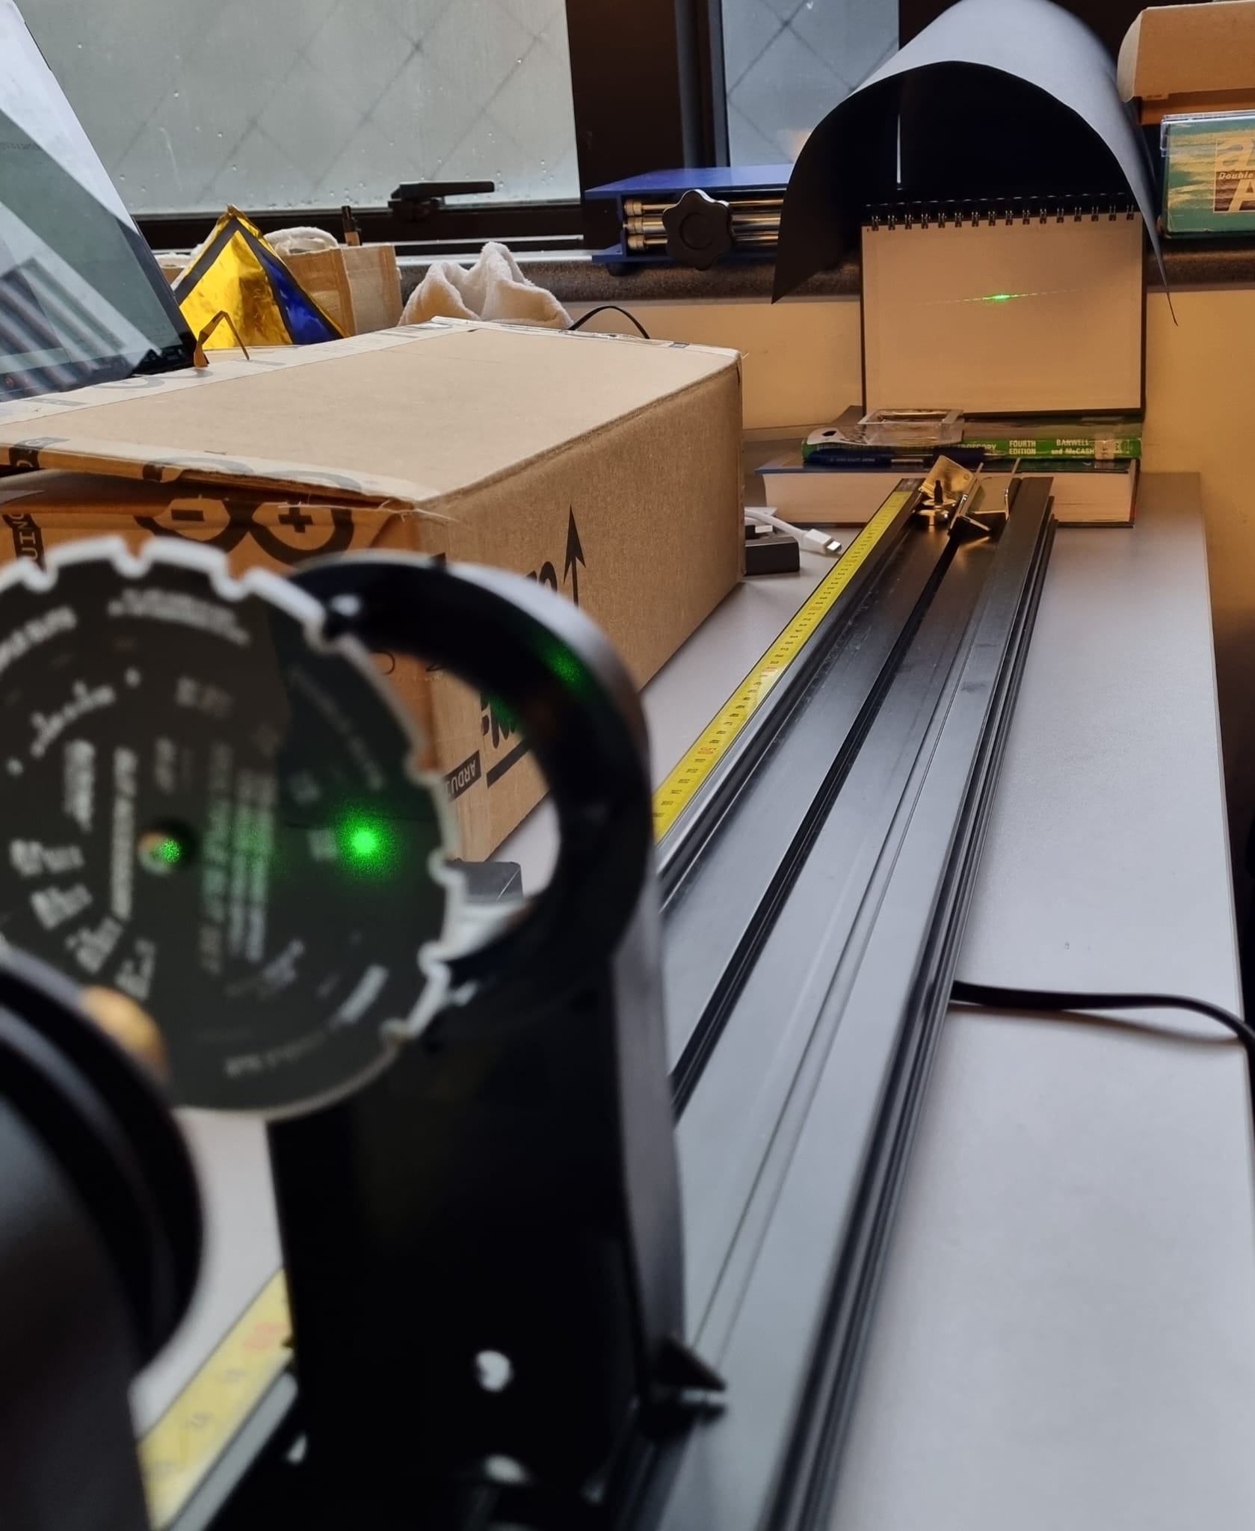
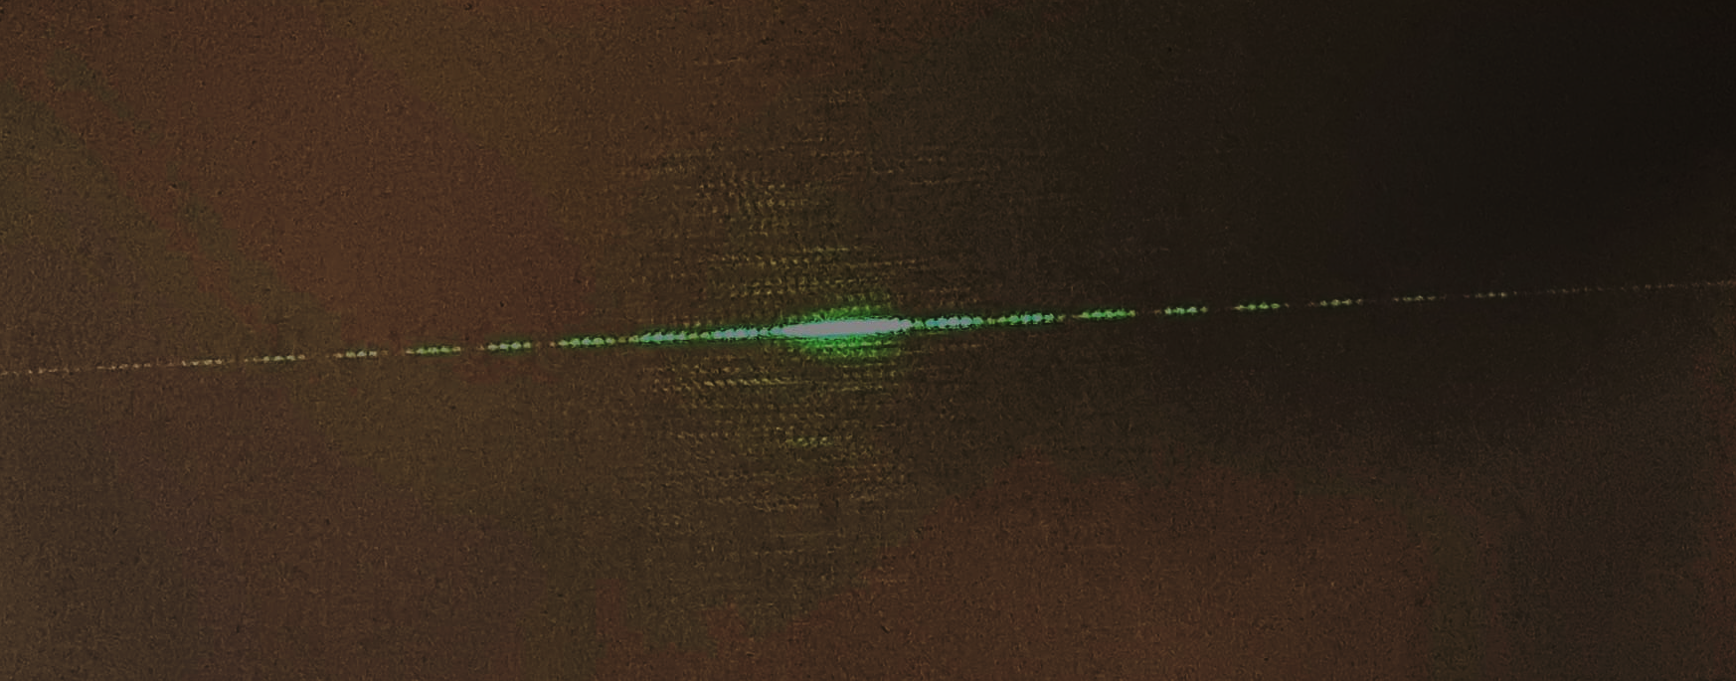
Light is a wave!
Light is a wave!

Slide 8
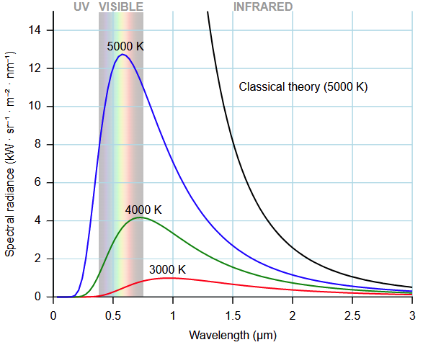
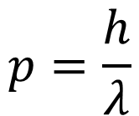
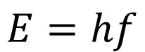
Light is a particle!
Einstein obtain the correct blackbody spectra by treating light as particles
Treating light as waves (5000K).
Do not correspond with experiment.
$$E=hf$$
$$p=\frac{h}{λ}$$
Image credit: D. Kule, PD

Slide 9
Light can be waves. Light can also be particles.
It depends on how you “look” at it.

Slide 10
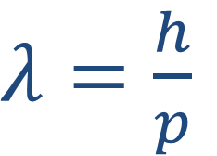
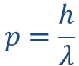
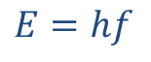
Matter can be waves too!
Wait…what???
de Broglie (1924):
If light is both particle and wave, let the same applies for matter too!
Motivated by Einstein’s expressions for the energy and momentum for a photon:
$λ=\frac{h}{p}$
$$E=hf$$
$$p=\frac{h}{λ}$$
Everything exhibits wave-particle duality.

Slide 11
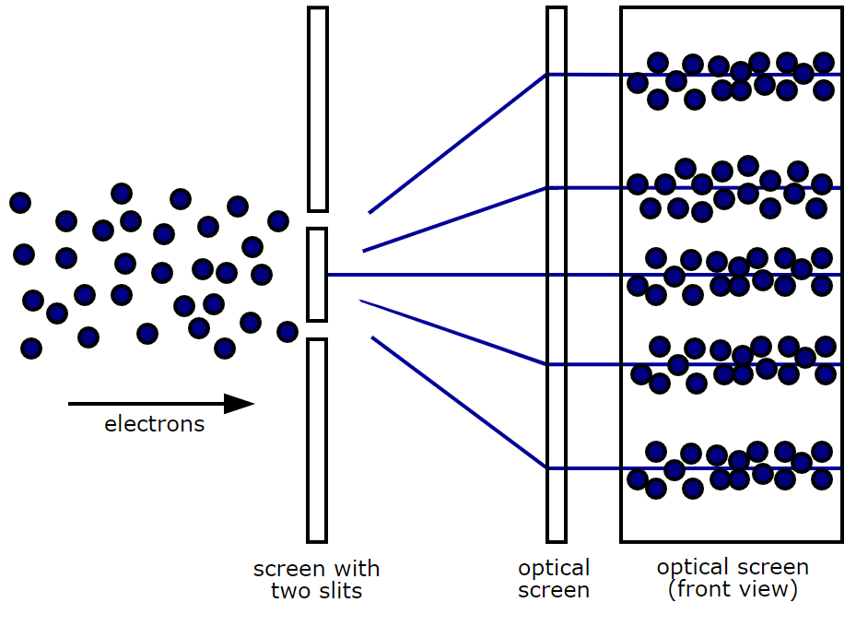
Matter are Waves
How to prove it experimentally?
Image credit: inductiveload, public domain

Slide 12


Slide 13
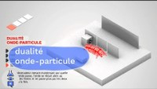
xx

Slide 14
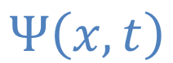
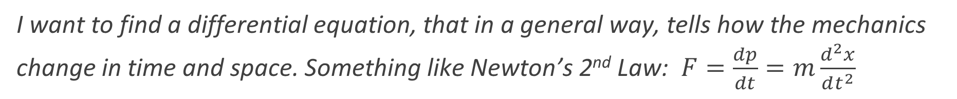
Wave mechanics for a quantum particle
Erwin Schrödinger (1925):
I like de Broglie’s matter waves idea. Let me make it into a proper theory.
Let all the mechanics of a particle be encoded in a “wavefunction”:
$$Ψ\left(x,t\right)$$
I want to find a differential equation, that in a general way, tells how the mechanics change in time and space. Something like Newton’s 2nd Law: $F=\frac{dp}{dt}=m\frac{d^{2}x}{dt^{2}}$

Slide 15
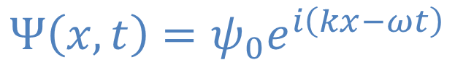
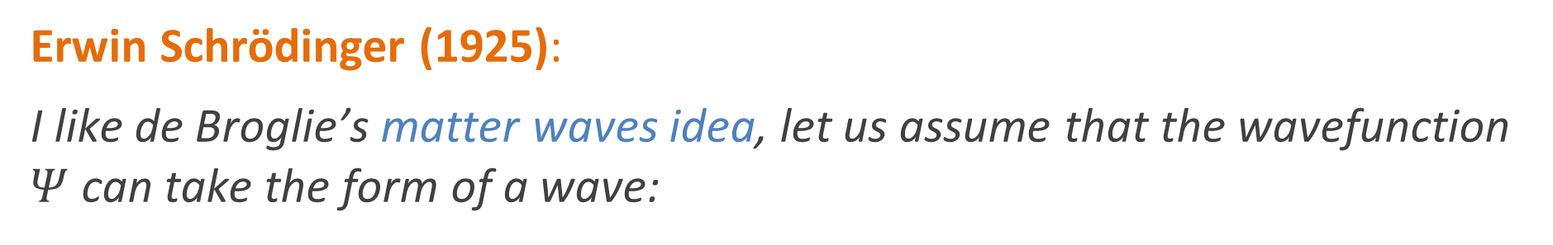
Wave mechanics for a quantum particle
Erwin Schrödinger (1925):
I like de Broglie’s matter waves idea, let us assume that the wavefunction $Ψ$ can take the form of a wave:
$$Ψ\left(x,t\right)=ψ_{0}e^{i\left(kx−ωt\right)}$$
Note: $k$ and $ω$ are related to wavelength and frequency by $k=\frac{2π}{λ}$ and $ω=2πf$

Slide 16
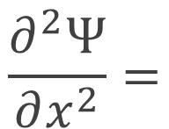
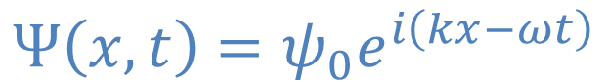
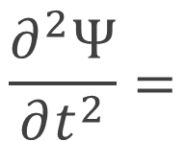
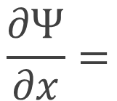
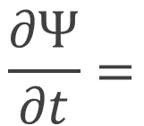
Wave mechanics for a quantum particle
Erwin Schrödinger (1925):
How to make a differential equation for the wavefunction? Let’s examine the derivatives first…
$$Ψ\left(x,t\right)=ψ_{0}e^{i\left(kx−ωt\right)}$$
$$\frac{∂Ψ}{∂t}=$$
$$\frac{∂^{2}Ψ}{∂t^{2}}=$$
$$\frac{∂Ψ}{∂x}=$$
$$\frac{∂^{2}Ψ}{∂x^{2}}=$$

Slide 17
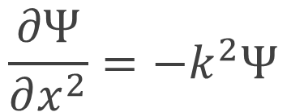
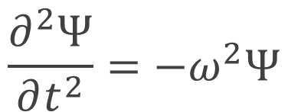
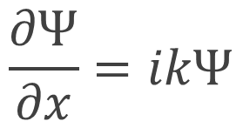
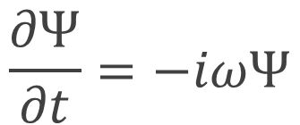
Wave mechanics for a quantum particle
Erwin Schrödinger (1925):
How to make a differential equation for the wavefunction? Let’s examine the derivatives first…
$$Ψ\left(x,t\right)=ψ_{0}e^{i\left(kx−ωt\right)}$$
$$\frac{∂Ψ}{∂t}=−iωΨ$$
$$\frac{∂^{2}Ψ}{∂t^{2}}=−ω^{2}Ψ$$
$$\frac{∂Ψ}{∂x}=ikΨ$$
$$\frac{∂Ψ}{∂x^{2}}=−k^{2}Ψ$$

Slide 18
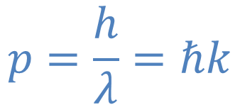

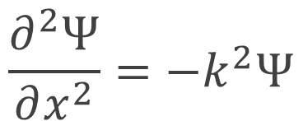
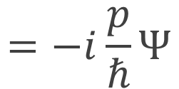
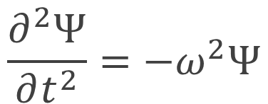
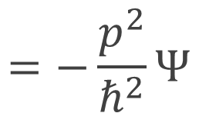
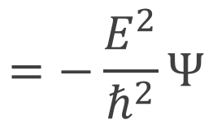
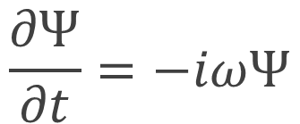
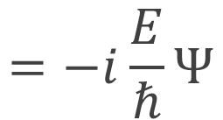
Wave mechanics for a quantum particle
Erwin Schrödinger (1925):
Using de Broglie’s matter waves equations
$$p=\frac{h}{λ}=ℏk$$
$$E=hf=ℏω ,$$
$$\frac{∂Ψ}{∂t}=−iωΨ$$
$$=−i\frac{E}{ℏ}Ψ$$
$$\frac{∂^{2}Ψ}{∂t^{2}}=−ω^{2}Ψ$$
$$=−\frac{E^{2}}{ℏ^{2}}Ψ$$
$$\frac{∂Ψ}{∂x}=ikΨ$$
$$=−i\frac{p}{ℏ}Ψ$$
$$\frac{∂^{2}Ψ}{∂x^{2}}=−k^{2}Ψ$$
$$=−\frac{p^{2}}{ℏ^{2}}Ψ$$

Slide 19
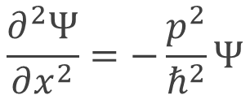
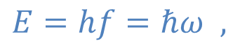
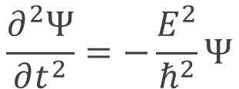





Wave mechanics for a quantum particle
Erwin Schrödinger (1925): All the mechanics are encoded in a “wavefunction” $Ψ$
Guided by de Broglie’s matter waves idea:
$$Ψ\left(x,t\right)=ψ_{0}e^{i\left(kx−ωt\right)}$$
$$\frac{∂Ψ}{∂t}=−i\frac{E}{ℏ}Ψ$$
$$\frac{∂Ψ}{∂x}=−i\frac{p}{ℏ}Ψ$$
$$E=hf=ℏω ,$$
$$\frac{∂^{2}Ψ}{∂t^{2}}=−\frac{E^{2}}{ℏ^{2}}Ψ$$
$$\frac{∂^{2}Ψ}{∂x^{2}}=−\frac{p^{2}}{ℏ^{2}}Ψ$$
$$p=\frac{h}{λ}=ℏk$$
The energy of the system consists of kinetic and potential energy
$$E=\frac{p^{2}}{2m}+V(x)$$

Slide 20





Wave mechanics for a quantum particle
The energy of the system consists of kinetic and potential energy
$$E=\frac{p^{2}}{2m}+V(x)$$
$$\frac{∂Ψ}{∂t}=−i\frac{E}{ℏ}Ψ$$
$$EΨ=\frac{p^{2}}{2m}Ψ+V\left(x\right)Ψ$$
$$\frac{∂^{2}Ψ}{∂x^{2}}=−\frac{p^{2}}{ℏ^{2}}Ψ$$
Schrödinger’s equation
$$iℏ\frac{∂Ψ}{∂t}=−\frac{ℏ^{2}}{2m}\frac{∂^{2}Ψ}{∂x^{2}}+V\left(x\right)Ψ$$

Slide 21


Wave mechanics for a quantum particle
Schrödinger’s equation
$$iℏ\frac{∂Ψ}{∂t}=−\frac{ℏ^{2}}{2m}\frac{∂^{2}Ψ}{∂x^{2}}+V\left(x\right)Ψ$$
$Ψ$: a device that encodes mechanical information of a particle
$$k=\frac{p}{ℏ} , ω=\frac{E}{ℏ}$$
A solution of the SE is$Ψ\left(x,t\right)=ψ_{0}e^{i\left(kx−ωt\right)}$ $=ψ\left(x\right)e^{−iωt}$

Slide 22



Wave mechanics for a quantum particle
A worthy digression: The linear combination of the solution is also a solution!
$$iℏ\frac{∂Ψ}{∂t}=−\frac{ℏ^{2}}{2m}\frac{∂^{2}Ψ}{∂x^{2}}+V\left(x\right)Ψ$$
A solution:$Ψ\left(x,t\right)=ψ_{0}e^{i\left(kx−ωt\right)}$
$$Ψ\left(x,t\right)=\sum_{n}{c_{n}ψ_{0}e^{i\left(k_{n}x−ω_{n}t\right)}}$$
And this Fourier series can be made into anything!
See Ervin’s article on Fourier series.

Slide 23



Wave mechanics for a quantum particle
SE:
$$iℏ\frac{∂Ψ}{∂t}=−\frac{ℏ^{2}}{2m}\frac{∂^{2}Ψ}{∂x^{2}}+V\left(x\right)Ψ$$
A solution:$Ψ\left(x,t\right)=ψ_{0}e^{i\left(kx−ωt\right)}=ψ\left(x\right)e^{−iωt}$
Putting this into the SE,
$$iℏ\left(−iω\right)e^{−iωt}ψ(x) =−\frac{ℏ^{2}}{2m}\frac{∂^{2}ψ}{∂x^{2}}e^{−iωt}+V\left(x\right)ψ\left(x\right)e^{−iωt}$$
$$E ψ(x) =−\frac{ℏ^{2}}{2m}\frac{∂^{2}ψ}{∂x^{2}}+V\left(x\right)ψ\left(x\right)$$
Time independent Schrödinger’s equation

Slide 24


Wave mechanics for a quantum particle
Time independent Schrödinger’s equation
$$−\frac{ℏ^{2}}{2m}\frac{∂^{2}ψ}{∂x^{2}}+V\left(x\right)ψ\left(x\right)=E ψ(x)$$
? ? ? ?
How do we solve the SE?
What do we get in solving the SE?
What is $ψ(x)$ actually?
Is Schrödinger correct?
How we know?

Slide 25


Wave mechanics for a quantum particle
Time independent Schrödinger’s equation
$$−\frac{ℏ^{2}}{2m}\frac{∂^{2}ψ}{∂x^{2}}+V\left(x\right)ψ\left(x\right)=E ψ(x)$$
Q: How do we solve the SE?
A: The SE is really a differential equation. To solve, we need to know the potential energy $V\left(x\right)$ and the boundary conditions.
Q: What do we get in solving the SE?
A: We will get $ψ\left(x\right)$ and the energy condition needed to satisfy the BC.

Slide 26

Wave mechanics for a quantum particle
Time independent Schrödinger’s equation
$$−\frac{ℏ^{2}}{2m}\frac{∂^{2}ψ}{∂x^{2}}+V\left(x\right)ψ\left(x\right)=E ψ(x)$$
Q: What is $ψ(x)$ actually?
A: Nobody knows for sure! But one can use it to get information on a particle’s position, momentum and energy.
Q: Is Schrödinger correct? How we know?
A: Schrödinger derived the energy levels of the hydrogen and other atoms. His theory is also general enough to extend to non-atomic systems.

Slide 27



Q: What is $ψ(x)$ actually?
$$L=mvr$$
$$R$$
Probability of finding the particle in region R $=\int_{a}^{b}{{\left|Ψ\right|}^{2}dx}$

Slide 28








Particle-in-a-box
Potential Energy
$$V(x)=\left\{\begin{aligned}0 if 0<x<L \\ ∞ elsewhere\end{aligned}\right.$$
Boundary Conditions
$$ψ\left(0\right)=0$$
$$ψ\left(L\right)=0$$
$$V=∞$$
$$V=0$$
$$V=∞$$
$$x$$
$$0$$
$$L$$

Slide 29




Particle-in-a-box
Potential Energy
$$V(x)=\left\{\begin{aligned}0 if 0<x<L \\ ∞ elsewhere\end{aligned}\right.$$
Boundary Conditions
$$ψ\left(0\right)=0$$
$$ψ\left(L\right)=0$$
$$−\frac{ℏ^{2}}{2m}\frac{∂^{2}ψ}{∂x^{2}}=E ψ\left(x\right) , 0<x<L$$
SE:
Allowed Energy states
$$E=\frac{ℏ^{2}n^{2}π^{2}}{2mL^{2}}$$
$$ψ\left(x\right)=\sqrt{\frac{2}{L}}\sin\left(\frac{nπ}{L}x\right)$$
We’ll derive these in the IS!
Allowed wavefunctions

Slide 30








Hydrogen atom
Potential Energy
$$V\left(x\right)=\frac{1}{4πε_{0}}\frac{e^{2}}{r}$$
Boundary Conditions
$$ψ\left(0\right)=0$$
$$ψ\left(∞\right)=0$$
-
$$−\frac{ℏ^{2}}{2m}∇^{2}ψ−\frac{1}{4πε_{0}}\frac{e^{2}}{r}ψ=E ψ$$
SE:
$$r$$
+
Allowed Energy states
$$E=\frac{e^{4}m_{e}}{32ε_{0}^{2}ℏ^{2}}\frac{1}{n^{2}}$$
Allowed wavefunctions
$$ψ_{n=1,l=0,m_{l}=0}=\frac{1}{\sqrt{π}a_{0}^{3/2}}e^{−r/a_{0}}$$
$${, ψ}_{n=2,l=0,m_{l}=0}=…$$
$$, …$$

Slide 31




Hydrogen atom
Potential Energy
$$V\left(x\right)=\frac{1}{4πε_{0}}\frac{e^{2}}{r}$$
Allowed Energy states
$$E=\frac{e^{4}m_{e}}{32ε_{0}^{2}ℏ^{2}}\frac{1}{n^{2}}$$
Boundary Conditions
$$ψ\left(0\right)=0$$
$$ψ\left(∞\right)=0$$
Allowed wavefunctions

Slide 32
End of week 4 lecture

Slide 33


Atomic Spectrum Experiment
25% of the grade :)
Part 1
Understand the principles of a spectrometer
Record and identify different atomic spectrums
Part 2

Slide 34




Atomic Spectrum Experiment
25% of the grade :)
Part 2
Build your own spectrometer
Record and Analyze different atomic spectra
TEST YOUR MIGHT

Slide 35
Discussion Question 1
Waves exhibit superposition.
What physical phenomena are a result of superposition of waves?

Slide 36
Discussion Question 2
We saw how light passing through 2 slits exhibit a diffraction pattern and understood it from the principle of superposition. Light passing through a single slit also creates a diffraction pattern. Explain single slit diffraction qualitatively.

Slide 37
Discussion Question 3
How did Einstein use the particle model of light to explain the findings of the photoelectric effect experiment?

Slide 38
Discussion Question 4
How is spectroscopy used in other areas of science? Name some examples!

Slide 39
Discussion Question 5
Derive the Rydberg formula Eq.(3.8) using the Bohr model. Evaluate the Rydberg constant R.

Slide 40
Discussion Question 6
Plot the spectra of the Lyman and Balmer series computationally.

Slide 41
Discussion Question 7
Derive the allowed energy states and wavefunction for particle in a box given Eq.(3.32) and Eq.(3.33).

Slide 42
Discussion Question 8
Graph the particle in a box wavefunction for n =1, 2 and 3. Label each sketch with the value of energy associated
with each n.

